Slide 1
Serving on the Camino
Raul E. Damas
Rotary Club of Key Biscayne
October 21, 2022

Slide 2
AGEndA
Seeds of the Camino
Historical context
The Journey
Volunteering
Summary
2

Slide 3
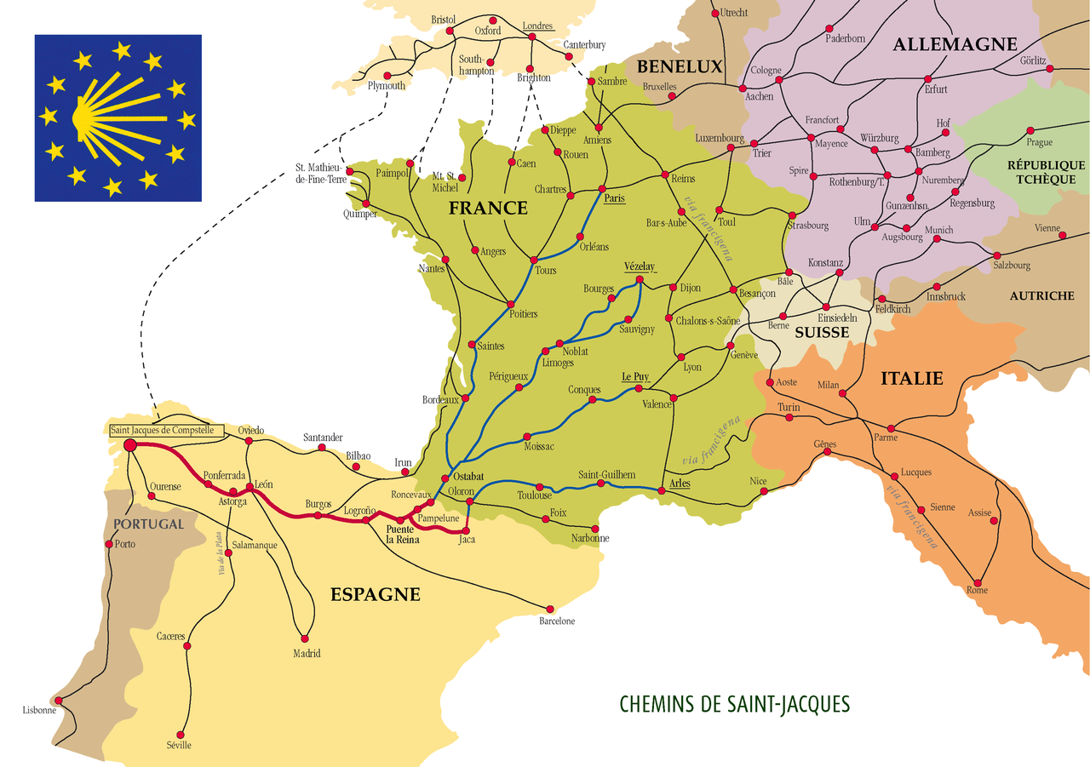
3

Slide 4
Seeds of the Camino
Historical context – Rome and Jerusalem
Santiago Apostol St James legend
Discovery of remains in Galicia
Other traditions: Celts, Hajj (Islam), Japan (Kumano Kodo Trail), Israel National Trail, Tibet (Mt. Kailas)
Resurgence of Camino in XX and XXl Centuries
4

Slide 5
Camino Routes
5

Slide 6
THE WAY
??? Seen “The WAY “ ???
The Way is a 2010 drama film directed, produced and written by Emilio Estevez and starring Martin Sheen. In it, The main character walks the Camino de Santiago, a traditional pilgrimage route in France and Spain.
6

Slide 7
What is the Camino
Many Caminos
The CAMINO: starts the moment you leave home > Stgo. de Compostela
Rooted in its pagan, Roman and Christian history
Open to everyone, all Religions or none
Most walk / bike / or horse the Camino Frances - last 100kms from Sarria, Galicia or St Jean Pied de Port in France(800kms)
Others start in Paris, Berlin, Ireland, UK, Rome,…
7

Slide 8
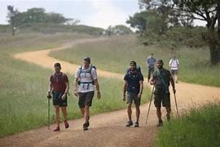
Why so special?
How to proceed in life, inner need, retired, bereavement, camaraderie, disconnect
Galicia, Spain: The Camino de Santiago Pilgrimage
https://www.youtube.com/watch?v=E_2sGATllOM
8

Slide 9
The Journey
Planning and Preparations
Reservations
Walking → Stamp the Credential
Albergues – bed, bath, meals (low fee or donation) - private, municipal, church
Upon arrival in Santiago, meet the Pilgrim Office
Mass → Botafumeiro
9

Slide 10
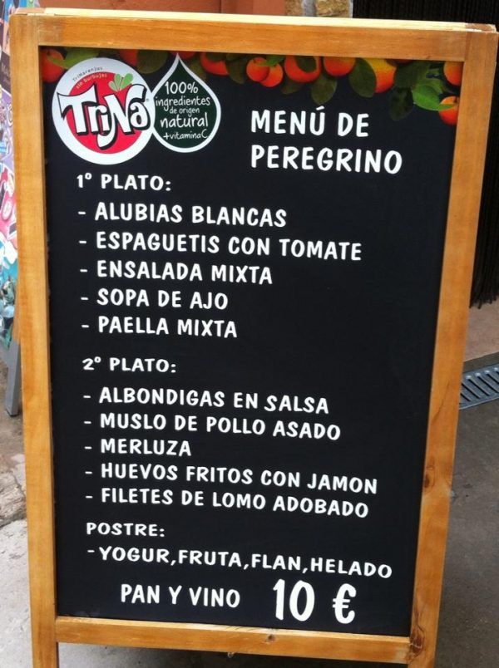
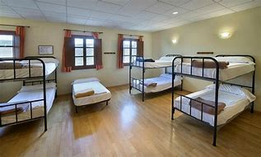
THE JOURNEY
10

Slide 11
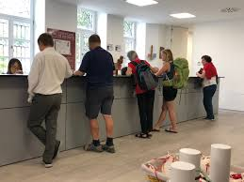
Volunteering = Serving
Albergues: Hospitalero → site caretaker
Pilgrim Office: Voluntario → welcome, collect statistics, review credential, issue “Compostela” certificate in Latin, logistics to get home, medical assistance.
11

Slide 12
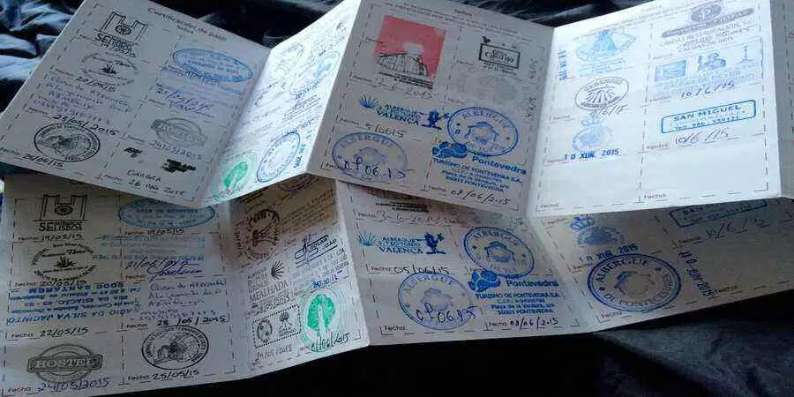
CREDENCIAL
Passport on the Camino
nextprevious
Close

Slide 13
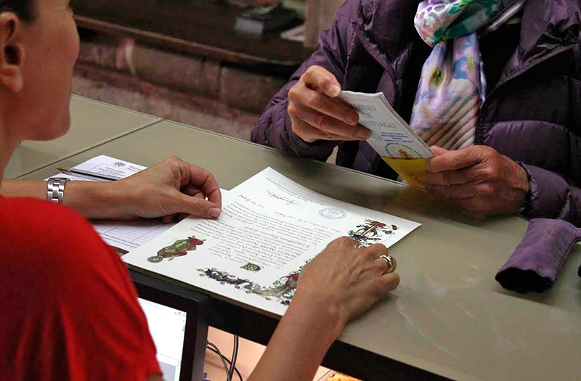
Compostela
Pilgrims from: Spain (50%), Italy, France, Germany, Brazil, Ukraine, Israel, Korea, Palestine, China, +++
Statistics:
1972 – 67 pilgrims
2022 - Oct. 5th 382,000+

Slide 14
Summary
Equalizes people, camaraderie, spiritual.
Go back to basics – clothes, shelter and food
Service, help each other = Rotary
Tradition: Compostela forgiveness for mistakes
for example: Prisoners’ pilgrimage
Next Steps:
Plan to walk next year with my 11 years old grand daughter
14

Slide 15
THANKS
Contact information: RAUL E. DAMAS redamas@aol.com – 305.335.4089
South Florida chapter APOC American Pilgrims on the Camino
https://americanpilgrims.org/iwpmap_directory/south-florida/
15

