Slide 1


POLIO ERRADICATION UPDATE
Patricia Riestra Peraita
Rotary Club of Key Biscayne
December 09, 2022

Slide 2

OUR GOAL
https://www.rotary.org/en/our-causes/ending-polio

Slide 3
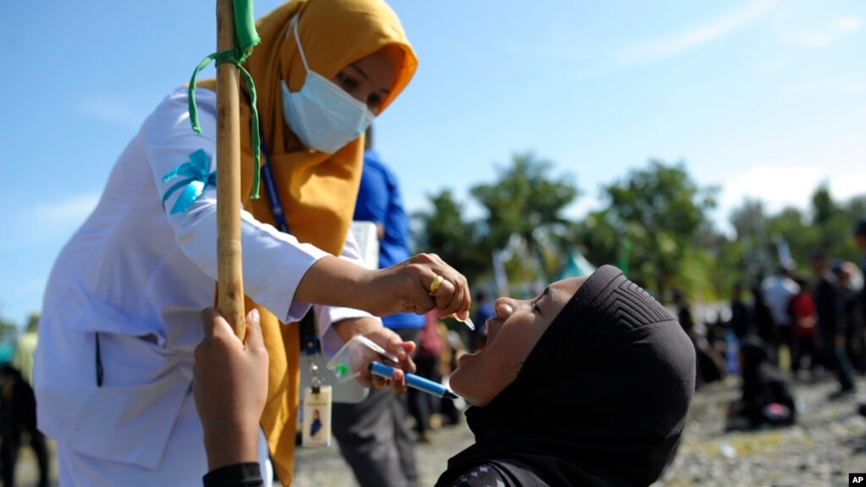
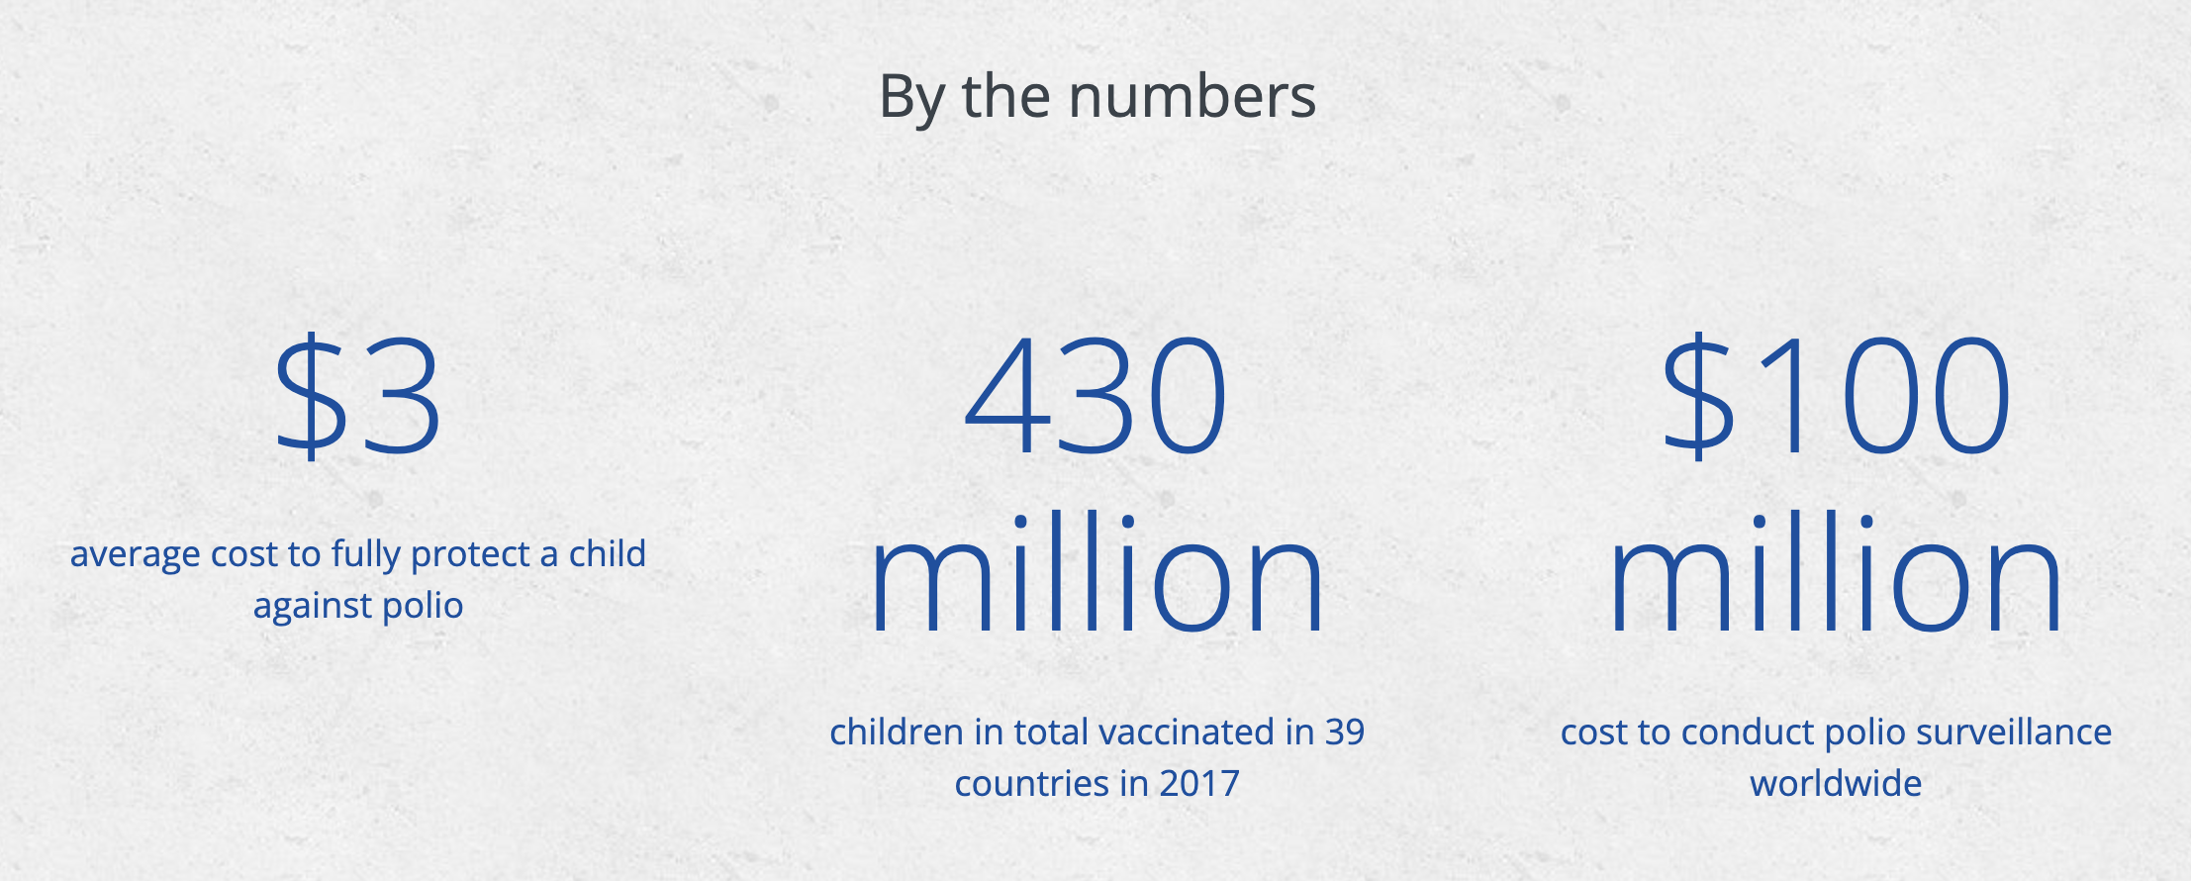
POLIO BY THE NUMBERS
Rotary’s World-wide 2022-23
Rotary Year Polio Fundraising Goal is $150 Million
Including the Gates Foundation $2 to $1 Match
https://www.rotary.org/en/our-causes/ending-polio

Slide 4
GOAL TRACKING
Our Goal is Global Polio Eradication!
A Win Against Polio is a Win For Global Health!
Advocate, Donate & Educate to END POLIO NOW & FOREVER!
20,000,000 Children Saved from the Paralysis of Polio Since 1988
Total paralysis cases | Year-to-date 2022 | Total 2021 | Total 2020 | Total 2019 | Total 2018
Globally | 30 | 6 | 140 | 176 | 33
- in endemic countries: | 22 | 5 | 140 | 176 | 33
- in post-endemic countries: | 8 | 1 | 0 | 0 | 0

Slide 5
CASES REPORTED
Wild Polio cases reported in the past week:
Pakistan 0, Afghanistan 0, Mozambique 0
2022 Wild Polio Cases – Pakistan 20, Afghanistan 2, Mozambique 8
2021 Wild Cases - Pakistan 1 (2020-84), Afghanistan 4 (2020-56), Malawi - 1
2022 Vaccine Derived Polio Cases – 575 in 20 Countries
2021 Vaccine Derived Polio - 689 Cases in 22 Countries (2020-1,113 Cases in 26 countries)
Terry Ziegler, bigzlumber@aol.com Rotary Region 26 Endowment/Major Gifts Adviser

Slide 6
No new Wild Polio cases reported this week
What is that Polio Picture? Indonesia
One case of circulating vaccine-derived poliovirus type 2 (cVDPV2) was reported this week, with onset of paralysis on 9 October, from Aceh province. It is the first case reported from the country. Genetically-linked virus was also isolated from three healthy community contacts.
A risk assessment and field investigation is currently ongoing by local and national public health authorities, and supported by partners of the Global Polio Eradication Initiative, including to assess more clearly the origin of the isolated viruses. The Ministry of Health has publicly announced the outbreak, and catch-up immunization campaigns were launched in the immediately-affected area on 28 November, targeting 1.2 million children under the age of 13 years.
Based on a detailed risk assessment, two large-scale vaccination campaigns are planned, one each in January and February 2023, covering four provinces (Aceh, North Sumatera, Riau and West Sumatera), targeting 3.7 million children.
Terry Ziegler, bigzlumber@aol.com Rotary Region 26 Endowment/Major Gifts Adviser

Slide 7
Circulating Vaccine Derived Polio Cases
Year | Cases | Countries
2020 | 1,113 | 26
2021 | 689 | 22
2022 | 575 | 20
Afghanistan 43
Algeria 1
Benin 7 (3 in 2021)
Central African Republic 3
Chad 22 (0 in 2021)
DR Congo 239 (28 in 2021)
Eritrea 1
Ethiopia 1
Ghana 2
Indonesia 1
Israel 1
Madagascar 10 (13 in 2021)
Malawi 3
Mozambique 16 (2 in 2021)
Niger 11 (18 in 2021)
Nigeria 42 (415 in 2021)
Pakistan 8
Somalia 4 (1 in 2021)
Togo 0
United States 1
Yemen 158 (69 in 2021)
New Polio Cases & Samples reported in the last week
Afghanistan - 2 WPV1 Samples,
D R Congo - 1 cVDPV1 Case,
Indonesia - 1 cVDPV2 Case,
Nigeria - 5 cVDPV2 Samples,
Yemen 4 cVDPV2 Cases.
Terry Ziegler, bigzlumber@aol.com Rotary Region 26 Endowment/Major Gifts Adviser

Slide 8
The Final Two Polio Endemic Countries
Pakistan
No new Wild Polio cases reported this week. Twenty Wild Polio cases reported in 2022.
One Wild Polio Case reported in 2021.
The most recent case had an onset of paralysis on 9/20/22.
No WPV1 Sample and no cVDPV2 Positive Environmental Samples were reported this week in Pakistan.
Afghanistan
No new Wild Polio cases reported this week.
Two Wild Polio Cases reported in 2022 .
Four Wild Polio cases reported in 2021 T
he most recent case had an onset of paralysis on 9/10/22.
Afghanistan reported 56 Wild Polio cases in 2020. Two WPV1 and no cVDPV2 Positive Environmental Samples were reported this week in Afghanistan.
Terry Ziegler, bigzlumber@aol.com Rotary Region 26 Endowment/Major Gifts Adviser

Slide 9

FRENCH CHRISTMAS MARKET
One Key Goal of Rotary International is to ERADICATE POLIO around the world.
This Sunday December 11, from 09:00 AM to 06:00 PM the French Bazaar will be host at the Key Biscayne Village Green.
Rotary Club of Key Biscayne will have a stand at the event offering: the Real Almond Cake from Chef Zandra Zampieri-Kaparis, unique design earrings from the artist Bre Vassar, Solar Lamps, and Christmas ornaments.
All proceeds will be applied to the Rotary Club of Key Biscayne POLIO Program to contribute to the eradication of Polio around the world. Help us out in this initiative buying the quality products offered. YOU will make the difference!

Slide 10
