Slide 1
There’s an Elephant in the Room…
f you find discussions of inequality to be painful, aggravating, exhausting, or even scary, it’s time to explore the elephant.

Slide 2
Chris Altizer, MBA, MA
Retired and Recovering HR Executive – Pfizer, Aetna
Thrice-published Author
Adjunct Faculty, Florida International University, Global Leadership & Management Dept.
Faculty Fellow – FIU Center for Leadership
Executive Coach – Altizer Performance Partners, LLC
MBSR Teacher – Univ. Cal. San Diego
Aerial Yoga Teacher – Ayama Yoga NMB
5th Degree Black Belt, Isshinryu Karate

Slide 3
Talking About Diversity, Equity, Inclusion Is…
Notes:
Let’s take a breath – Let’s make it real
Where do you sit?
Who do you hire? Coach? Mentor?
What are the business impacts of having a diverse team? Inclusive team?
How does it contribute to the Rotary Mission?
Our mission is to promote peace, to fight disease, to provide clean water, sanitation and hygiene, to protect mothers and children, to support education and to grow local economies.
Talking about this is….
Why is this hard to talk about?

Slide 4
What are we talking about?

Slide 5
The Never Cooling Potato – ‘privilege’
Fails in the workplace
Have it
Don’t have it
Instead of ‘privilege,’ ‘Advantage’
Earned
Unearned
Notes:
Reading from Robert to open

Slide 6
Anyone can earn Advantage, it’s just easier for some than others
The challenge and opportunity of “lived experience”
Notes:
Explain the model
Chris’s unearned advantages – yes in NY , but are they still in south Florida?
The role of ‘lived experience’ – instead of Rachel or Tucker or the radio personality, what is your actual lived experience?
How hard is it to accept that someone else’s lived experience is different from your own because of who they are or where they’re from?

Slide 7
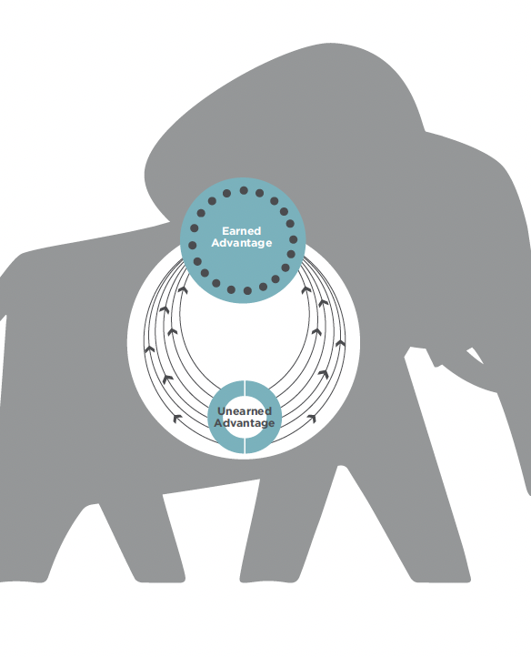
Growing Earned Advantage in Community
Unearned Advantage – however much you have or don’t have
Recognizing – Compassion, STOP
Working With – Growth Mindset and Intentions
Growing Earned Advantage
Being your own best teacher
Lived experiences – yours and others
Growth Advantage Mindset
Awareness – self, other, self-on-other
Notes:
What can I do?
Recognize - sympathy, empathy, compassion
Working with – growth mindset – attempt, fail, learn, succeed
Awareness – model
As leaders and owners – don’t underestimate the impact you have every day – “benefit of the doubt” “coaching, mentoring, power of words

Slide 8
Key Messages for RCoKB
Done well, focusing on diversity, equity, and inclusion contributes to individual, organizational, and community performance
Think Global, Act Local! Rotary is a beacon of not allowing the scope of global challenges drive reactions of flight, fight, freeze, or appease in daily life – you can face what’s uncomfortable and make a difference in the moment
Whoever you are, wherever you’re from, you can grow opportunities for earned advantage – for everyone.

Slide 9
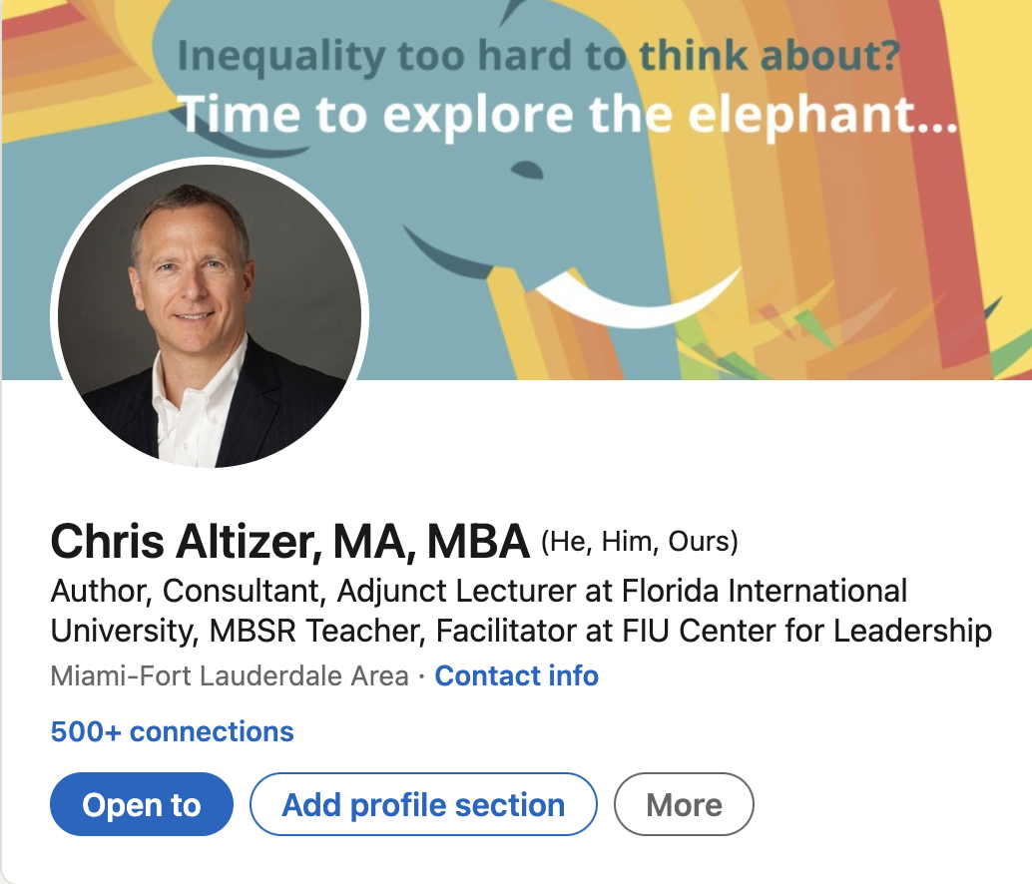
Learn more https://www.growingtheelephant.com/ https://www.altizerperformancepartners.com/ https://lead.fiu.edu/index.html chris@apppwi.com

