Slide 1
YOUR CLUB FOUNDATION AT WORK!
BRIEF ANNUAL REPORT 2022
By: Robert Brookes
Treasurer , RCKBF

Slide 2
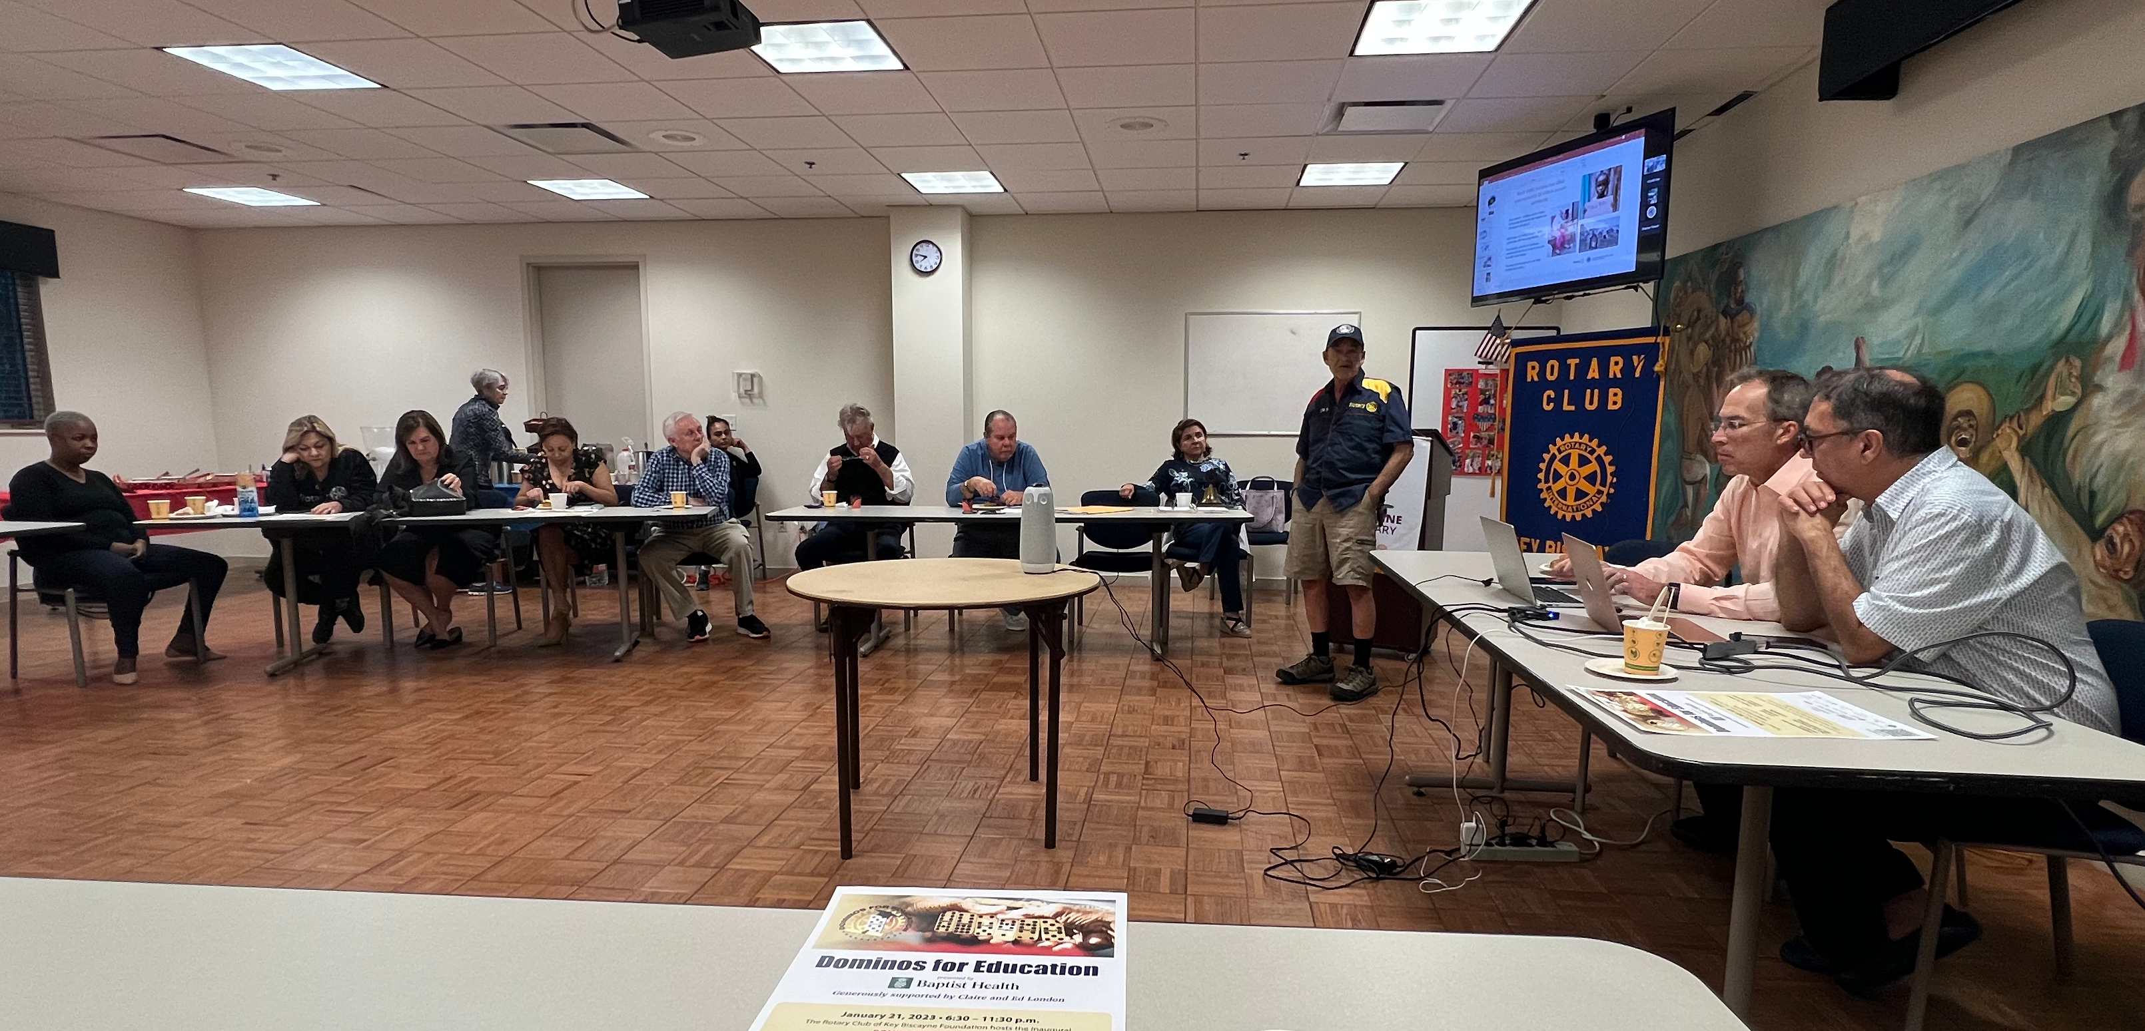
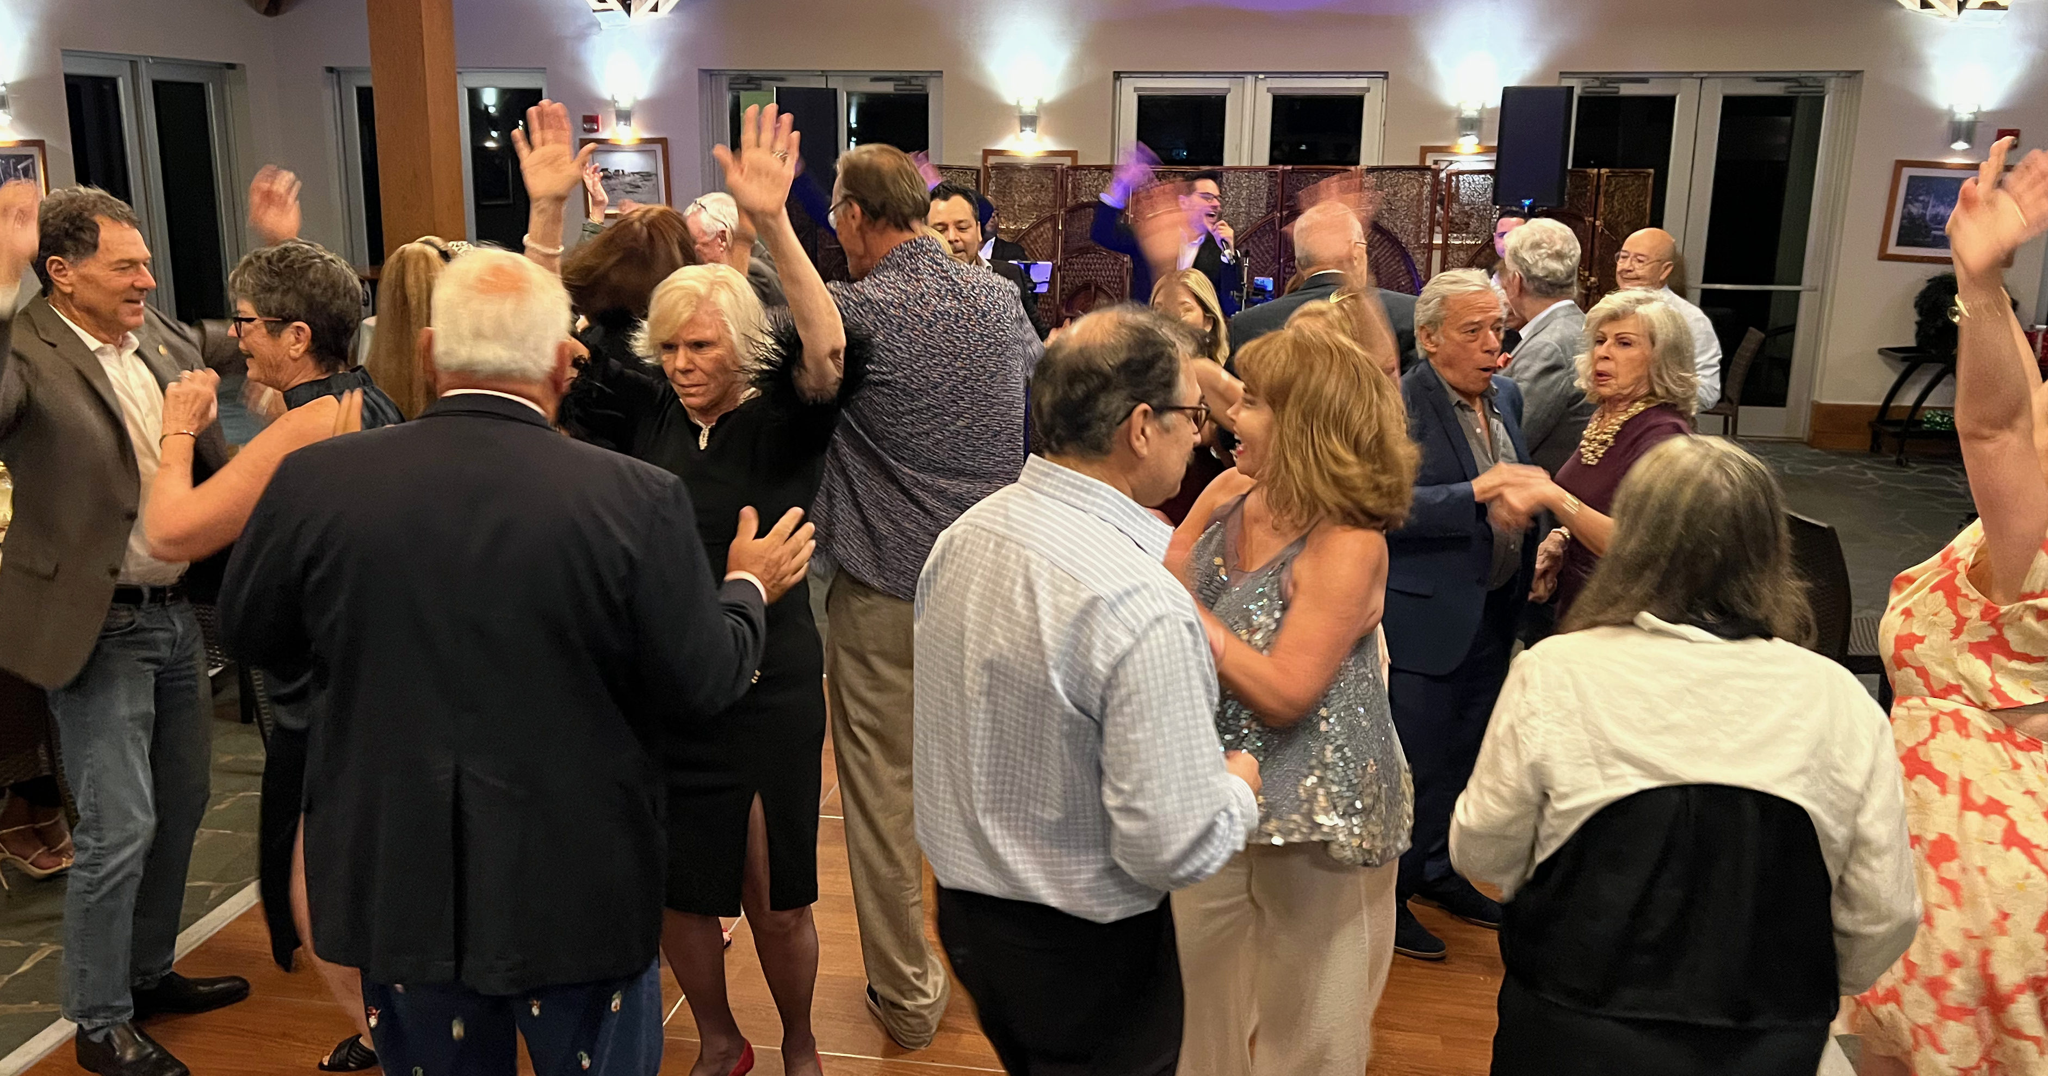
BUSY YEAR….. SO FAR!
LESSONS FORM THE PANDEMIC
STANDING STILL NOT AN OPTION!
9 MAJOR EVENTS!
COUNTLESS LIVES CHANGED
SERVICE ABOVE SELF ON STEROIDS!
OVER $500,000 TO PROJECTS!
HUGE TEAM AT THE READY…….

Slide 3
Team
BEHESTS
DICK McGILL
MEMBERS AND SPOUSES
BOOTS ON THE GROUND
PAST ROTARIANS

Slide 4
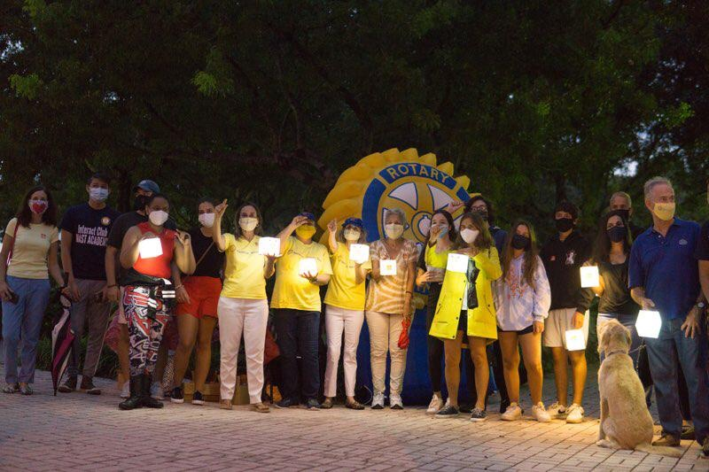
FROM KB WITH LOVE!
IMAGINE IT AND IT WILL HAPPEN!
THE POWER OF ROTARY IS INFECTIOUS, IMPERVIOUS TO VIRUSES, MULTIPLIES LIKE RABBITS, AND DOES GOOD WORLDWIDE!
……………….YOU MADE IT HAPPEN!

Slide 5
The way to get started is to quit talking and begin doing.
Walt Disney

Slide 6
$500,000 +
YOUR GENEROSITY MADE A DIFFERENCE!
YOUR IDEAS MADE IT HAPPEN
YOUR PASSION CARRIED IT OUT!

Slide 7
PROJECTS
PROJECT | RESULTS | PROJECT | RESULTS | PROJECT
JULY 4TH | $5,579 | WINE TASTING #17 | $3,170 | TEDDY BEAR PROJ: PRICELESS!
NICKLAUS CHILDREN’S | $335,000 | GIVE MIAMI DAY | $10,153 | DOMINOES 4 ED $60,000
EREY/TRF | $8,122 | EGLEE-HAWAPO | $6,000 | FLYING HIGH 4 HAITI Est $20,000
POLIO + BAZAAR | $6,900 | HURRICANE IAN | $1,300 | Erik-Hope Schools $6,000

Slide 8
SCHOLARSHIPS MAST INTERACT
$16,000 2021-22 INVESTING IN THE FUTURE

Slide 9
KBC FOUNDATION ASSETS Dec 31, 2022
IN THE BANK
CERTIFICATE OF DEPOSIT
INVESTMENT TRF Donor Advised Fund
INVENTORY IN STORAGE
$120,412
$100,000
$227,454
$10,000
Estimated
AND, ANOTHER VERY IMPORTANT ASSET………….

Slide 10
GOODWILL: YOU!!!
PRICELESS!
SERVICE -ABOVE -SELF

Slide 11
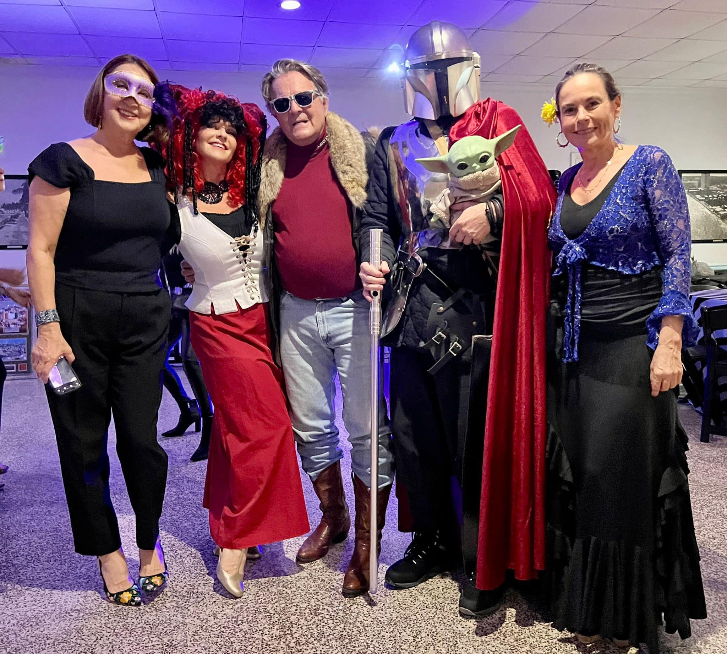
Thank You!
BOB BROOKES, TREASURER
ROTARY CLUB OF KEY BISCAYNE FOUNDATION

